Slide 1
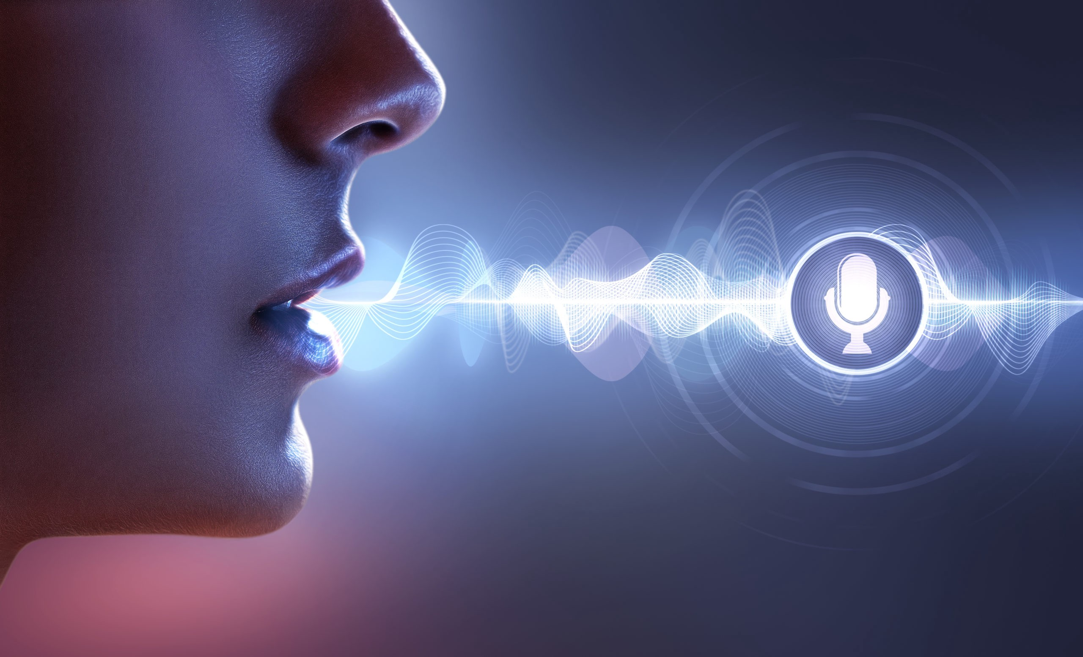
DONE BY K.JENNIFER [412719205004] V.VIJAYALAKSHMI [412719205017] SUPERVISED BY S.MURUGESAN ASSISTANT PROFESSOR(IT)
SPEECH EMOTION RECOGNITION FOR
CHILD SAFETY USING AIOT

Slide 2

ABSTRACT
The prime inspiration of this paper talks about the idea of safety and tracking device for child using AIOT Technologies.
The purpose of the device is to help parents locate their children with ease.
The system aims to enhance child safety by utilizing AIoT technologies in real-time speech emotion recognition with GSM and GPS to detect the child's live location and emotional state in danger situations.
The system offers numerous advantages, such as enhanced child safety, real-time monitoring, and minimal data storage requirements.

Slide 3
OBJECTIVE
The objective of this project is to develop a speech detection and emotion recognition system using AIOT Technology.
The detection of emotions only through audio conversations could be difficult without use of facial expressions.
To provide feedback to the user in the form of visual or audio cues in real-time.
To detect the voice on microphone and recognize the emotions.
It also track the live location of the user using GPS Tracker.
It detects the emotion and send the current emotional state of the user with live location.

Slide 4
LITERATURE SURVEY
AUTHOR/ YEAR/ PUBLICATION | TITLE | CONCEPT | ALGORITHM | ISSUES
J. Deng, X. Xu, Z. Zhang, S. Frühholz and B. Schuller (2018) | Semisupervised Auto encoders for Speech Emotion Recognition | The probabilistic rationality of speech classes can assess their integrated phonological possibilities. | CNN | Finding or detecting emotion is haystack. It is a challenge to make emotion available in different languages.
C. Fan, J. Yi, J. Tao, Z. Tian, B. Liu and Z. Wen (2016) | Gated Recurrent Fusion With Joint Training Framework for Robust End-to-End Speech Recognition | The new information theory framework is designed to measure the information transmitted by each phoneme attribute and to evaluate the quality of the phoneme recognition of speech development. | RNN | Performance and results of the emotion sensing system depends on accuracy of the sensors such as cameras, thermal image sensors, facial recognition algorithm used and so on.
J.Rong, G.Li, and Y.-P.P.Chen (2022) | Automatic speech emotion recognition using modulation spectral features | The former was derived from non-Japanese rough data, the latter from non-Japanese rough data However, these methods require a large amount of training data, and it is difficult to collect sufficient data from these some patients. | DNN | Highly accurate system will be expensive due to use of costly components.

Slide 5
AUTHOR/ YEAR/ PUBLICATION | TITLE | CONCEPT | ALGORITHM | ISSUES
L.Chai, J. Du, Q. -F. Liu and C. -H. Lee (2020) | A Cross-Entropy-Guided Measure (CEGM) for Assessing Speech Recognition Performance and Optimizing DNN-Based Speech Enhancement | That study investigates an end-to-end speech recognition system for Japanese people. Speech recognition systems have difficulty recognizing their speech because it is often irregular or vague. | DNN | Validation of emotion dataset is a challenge in order to have accurate emotion recognition system.
M. Sakurai and T. Kosaka (2021) | Emotion Recognition Combining Acoustic and Linguistic Features Based on Speech Recognition | The traditional automated speech recognition systems trained by neutral speech are significantly reduced. It identifies the problem of whisper recognition under disagreement. | ANN | There are limitations with different types and versions of the software such as dataset input is only textual data, image, pattern, video and audio inputs are invalid.
J. Han, Z.Zhang, F.Ringeval, and B.Schuller (2012) | Prediction-based learning for continuous emotion recognition in speech | To analyze this paradoxical training/experiment situation in-depth and develop effective whisper recognition methods, this study first analyses the phonological characteristics | RNN | It is a challenge to make emotion available in different languages.

Slide 6
EXISTING SYSTEM
The existing system which help to track the daily activity of children and also help to find the child using Wi-Fi and Bluetooth services present on the device.
The speech and emotion recognition system should recorded the audio from a conversation is first stored in cloud storage, and then processed offline using algorithms to detect emotions in the speech.
The emotion detection results are then stored in the cloud along with the original audio data.
DISADVANTAGE
Security risks
Delayed response
Dependence on internet connectivity
Cost
Reliability

Slide 7
PROPOSED SYSTEM
The proposed system for real-time speech emotion recognition with GPS to send a message through GSM to detect the child's live location and emotional state in danger situations using the AIoT technologies.
The system consists of a microphone for capturing the child's speech signals, a GPS receiver for tracking the child's location in real-time, and a GSM module for sending SMS messages to a predefined number in case of emergency.
The speech signals are pre-processed to remove noise and enhance features, and then fed into a deep neural network for emotion recognition. The GPS receiver continuously tracks the child's location and sends real-time data to the system. In case of danger, the system sends an SMS message to a predefined phone number that includes the child's live location and emotional state.
ADVANTAGE
Real-time tracking
Cost-effective
Increased privacy and security
Customizable alerts

Slide 8
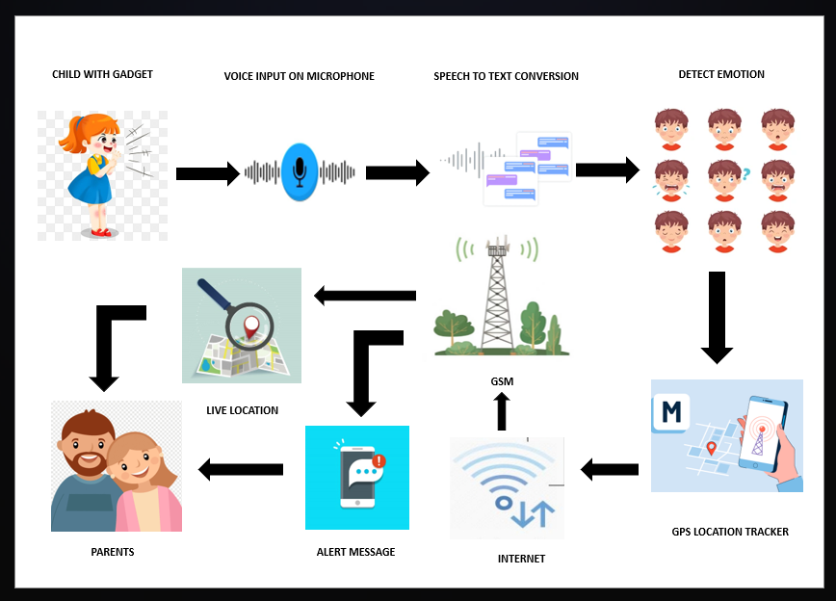
ARCHITECTURE DIAGRAM

Slide 9
HARDWARE REQUIREMENTS
GSM module : 800A
ARDUNIO NANO V3.0 DEVELOPMENT BOARD
JUMPER WIRE: Female – Female / Male – Female
GPS TRACKER
USB MICROPHONE

Slide 10
SOFTWARE REQUIREMENTS
Operating System: Windows
Software: Arduino IDE, PyCharm
Programming Language: C++, Python

Slide 11
MODULES
Speech Emotion Recognition (SER) Module
GSM Module for Sending Messages
GPS Module for Live Location Tracking

Slide 12
Speech Emotion Recognition (SER) Module:
Use a microphone module to capture audio input.
Implement an algorithm for speech feature extraction.
Train a machine learning or deep learning model to classify emotions based on the extracted features.
Use the trained model to recognize emotions in real-time.

Slide 13
GSM Module for Sending Messages:
Connect a GSM module (such as SIM900 or SIM800) to the Arduino Nano.
Utilize the appropriate library to interface with the GSM module and establish a connection with the cellular network.
Implement a function to send SMS messages containing relevant information, such as the recognized emotion and GPS coordinates.

Slide 14
GPS Module for Live Location Tracking:
Connect a GPS module to the Arduino Nano.
Use a library compatible with your GPS module to read GPS data, including latitude and longitude.
Implement a function to retrieve the current location from the GPS module.

Slide 15
CONCLUSION
In conclusion, the proposed system for real-time speech emotion recognition with GPS to send a message through GSM to detect the child's live location and emotional state in danger situations using the technology of IoT is a promising solution for improving child safety. This system integrates various technologies, including speech emotion recognition, GPS, GSM, and IoT, to provide accurate and real-time information about a child's emotional state and location. With this system, parents or caregivers can respond quickly to any potential danger or emergency, reducing the risk of harm to the child. Overall, this system has the potential to make a significant positive impact on child safety and well-being.

Slide 16
FUTURE ENHANCEMENT
For further development can improve a device by adding features like Integration with wearable devices: The system could be integrated with wearable devices, such as smartwatches or fitness trackers, to provide continuous monitoring of the child's location and emotional state. Multi-language support: The system could be expanded to support multiple languages, which could increase its usability in diverse communities. Advanced machine learning algorithms: The system could be improved by incorporating more advanced machine learning algorithms for speech emotion recognition, such as deep learning, which could improve accuracy and reliability. Enhanced privacy features: The system could be designed with enhanced privacy features, such as end-to-end encryption, to protect the child's personal data and prevent unauthorized access.

Slide 17
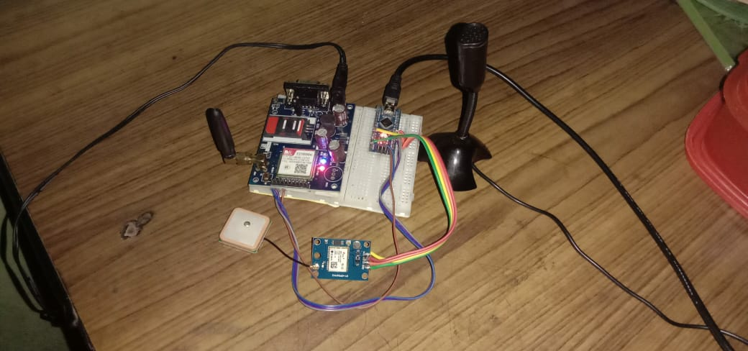
RESULT

Slide 18

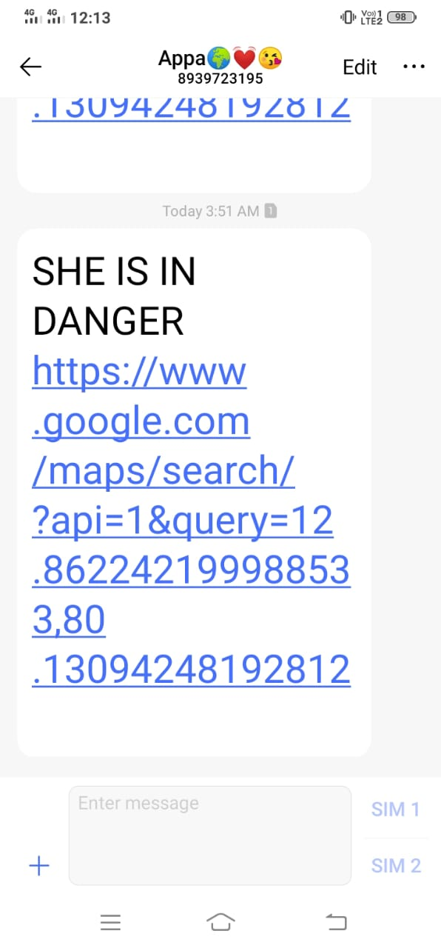

Slide 19
REFERENCES
Hao, R.Verma, and A.Nenkova, “Speaker-sensitive emotion recognition via ranking: Studies on acted and spontaneous speech”, Comput.Speech Lang., vol. 28, no.1, pp.186–202, Jan.2015.
L.Chen, X.Mao, Y.Xue, and L.L.Cheng, “Speech emotion recognition: Features and classification models”, Digit.Signal Process., vol.22, no.6, pp.1154–1160, Dec.2012
T.L.Nwe, S.W.Foo, and L.C.De Silva, “Speech emotion recognition using hidden Markov models”, Speech Commun., vol.41, no.4, pp.603–623, Nov.2003.
S.Wu, T.H.Falk, and W.-Y.Chan, “Automatic speech emotion recognition using modulation spectral features”, Speech Commun., vol.53, no.5, pp.768–785, May.2011.
J.Rong, G.Li, and Y.-P.P.Chen, “Acoustic feature selection for automatic emotion recognition from speech”, Inf.Process.Manag., vol.45, no.3, pp.315–328, May.2009.
C.-H.Wu and W.-B.Liang, “Emotion Recognition of Affective Speech Based on Multiple Classifiers Using Acoustic-Prosodic Information and Semantic Labels”, IEEE Trans.Affect.Comput., vol.2, no.1, pp.10–21, Jan.2011.
S.S.Narayanan, “Toward detecting emotions in spoken dialogs”, IEEE Trans.Speech Audio Process., vol.13, no.2, pp.293–303, Mar.2005.

Slide 20
E.Mower, M.J.Mataric, and S.Narayanan, “A framework for automatic human emotion classification using emotion profiles”, IEEE Trans.Audio, Speech, Language Process., vol.19, no.5, pp.1057-1070, Jul.2011.
J. Han, Z.Zhang, F.Ringeval, and B.Schuller, “Prediction-based learning for continuous emotion recognition in speech”, in Proc.IEEE Int.Conf.Acoust., Speech Signal Process.(ICASSP), Mar.2017, pp.5005-5009.
M.M.H.El Ayadi, M.S.Kamel, and F.Karray, “Speech Emotion Recognition using Gaussian Mixture Vector Autoregressive Models”, in 2007 IEEE International Conference on Acoustics, Speech and Signal Processing - ICASSP ’07, 2007, vol.4, pp.IV–957–IV–960.25
W.Dai, D.Han, Y.Dai, and D.Xu, “Emotion Recognition and Affective Computing on Vocal Social Media,” Inf. Manag., Feb. 2015.
R.Cowie, E.Douglas-Cowie, and C.Cox, “Beyond emotion archetypes: Databases for emotion modelling using neural networks”, Neural Netw.,vol.18, no.4, pp.371-388, 2005.
T.Vogt and E.André, “Comparing feature sets for acted and spontaneous speech in view of automatic emotion recognition”, in Proc.IEEE Int.Conf.Multimedia Expo (ICME), Jul.2005, pp.474-477.
C.-N.Anagnostopoulos, T.Iliou, and I.Giannoukos, “Features and classifiers for emotion recognition from speech: A survey from 2000 to 2011”, Artif.Intell.Rev., vol.43, no.2, pp.155-177, 2015

Slide 21
THANK YOU

